Slide 1
Parenting
Caring From Within
Team 2
Guo, Horkay, Nellis, Ying

Slide 2
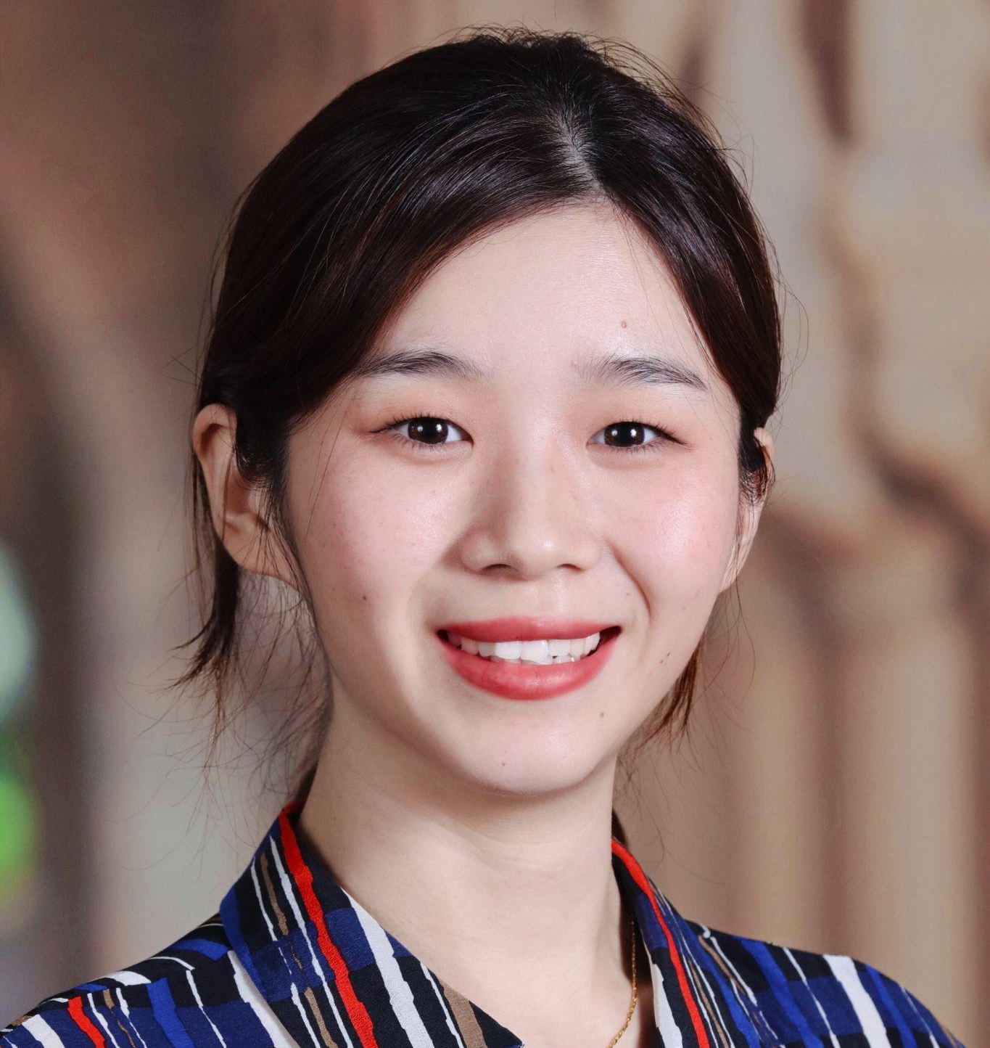
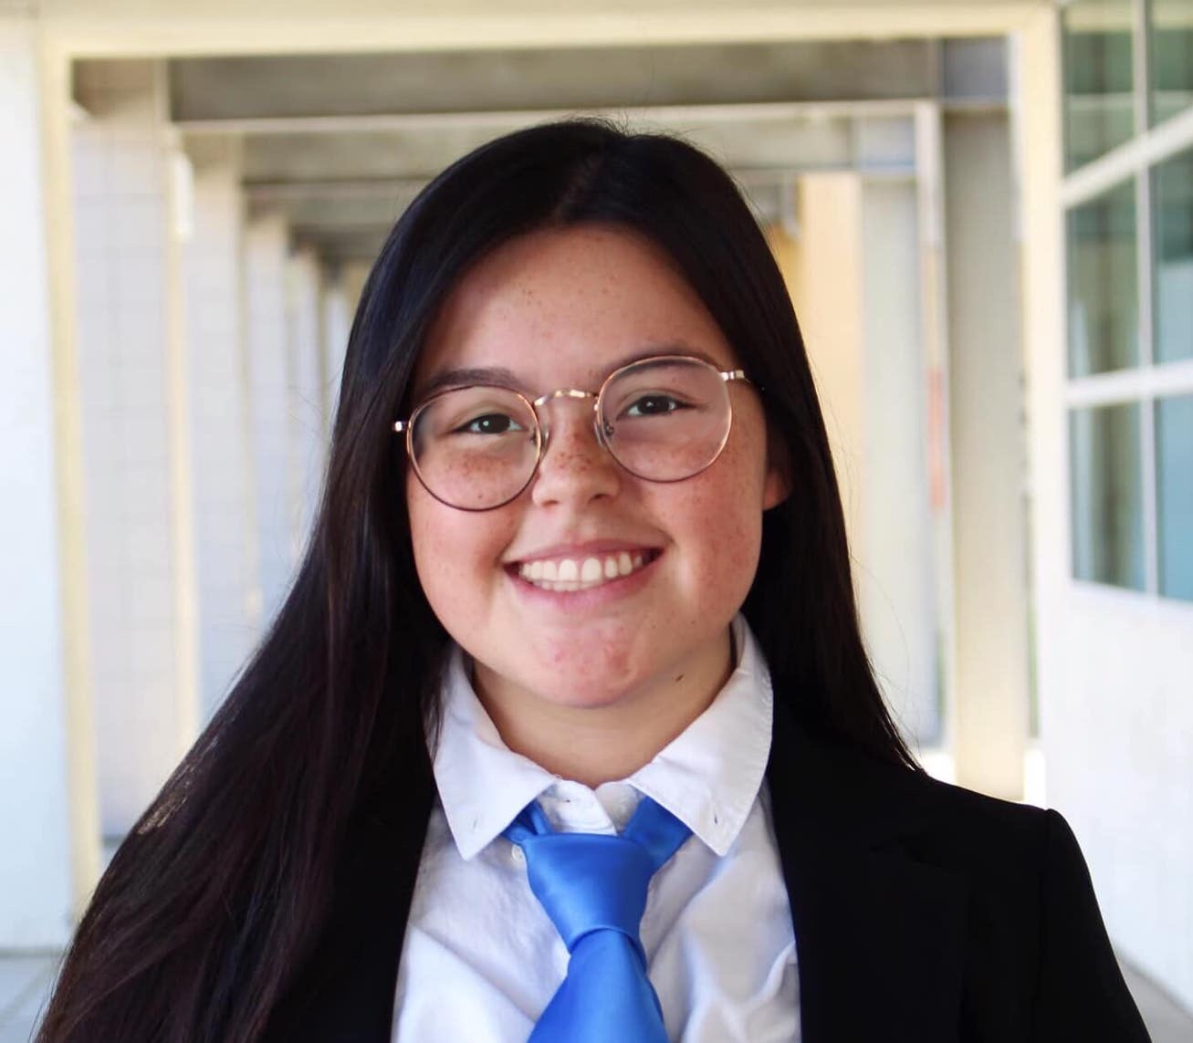

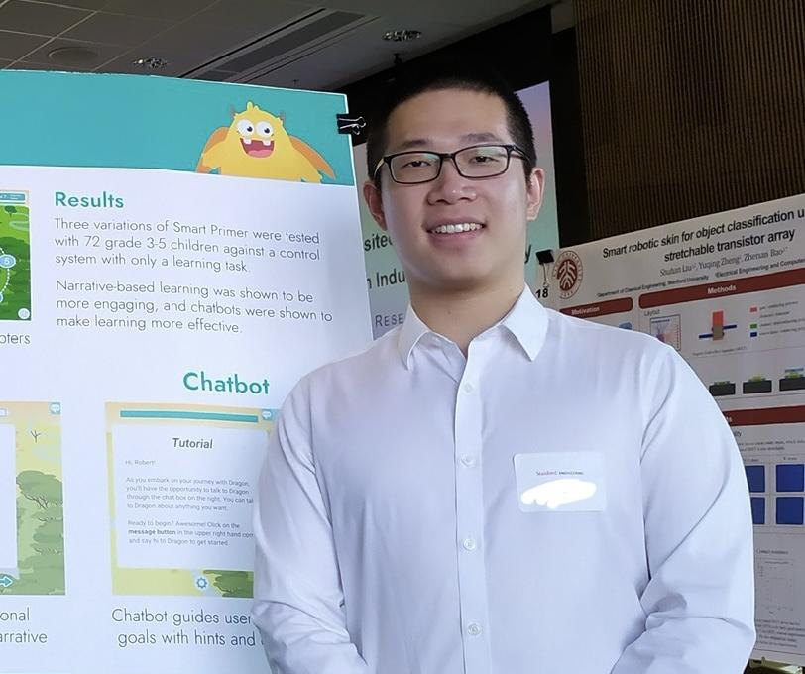
Our Team
Meng Guo
M.S. Symbolic Systems, C/O ‘23
Catherine Horkay
B.S. Computer Science (HCI),
C/O ‘23
Dyllen Nellis
B.S. Human-Centered Design and Engineering,
C/O ‘24
Rui Ying
M.S. Computer Science (HCI), C/ O ‘23

Slide 3

Parenting
Problem Domain:
Studio: Caring From Within
Notes:
Dynamic between parents and child

Slide 4
Needfinding
Methodology

Slide 5

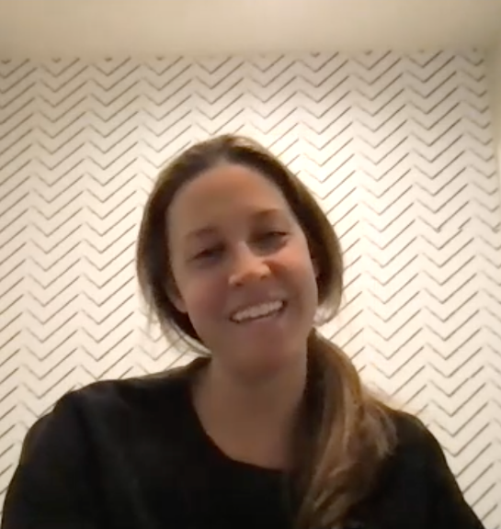
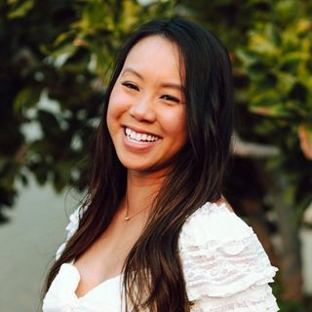
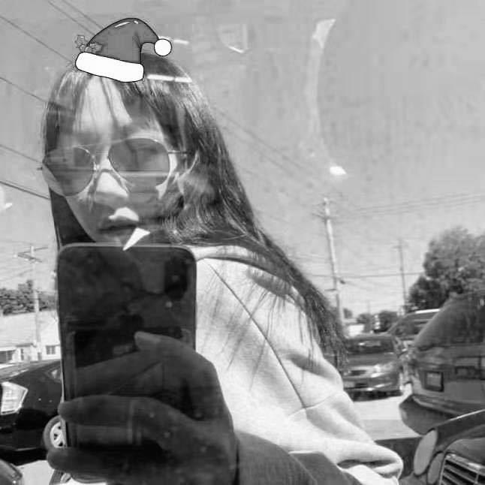
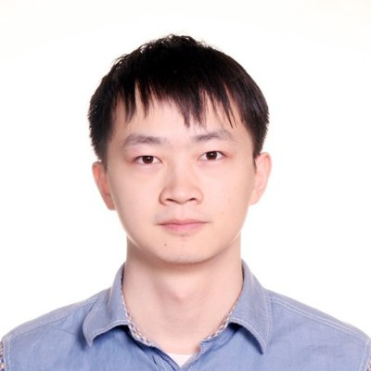
Interviewees
Allison
High School Math Teacher
Married
3 yr old girl, 5.5 yr old boy, 7.5 yr old girl
Kimsa
School Nurse
Married
15 month old girl,
3.5 yr old girl
Monica
Tech Recruiter
Single Mom / 1st-gen Immigrant
9 month old girl
Jiayue
Data Analyst
Bonan
Software Engineer
1st-gen Immigrants
12 day old newborn boy
Notes:
Races: Asian/White
Backgrounds: Non-immigrant/first generation immigrant
Financial status (?)
Roles: Father/mother
How they are recruited/compensated
Over zoom

Slide 6
Extreme User
Single Mom
Less Burden
More Burden
First-gen Immigrant
Easy Acclimation
Difficult Acclimation
Monica

Slide 7
Questions
What do you think are the most challenging aspects of bringing up a child?
How did you feel in the different phases of parenthood?
How do you think the way you were raised as a child has influenced you as a parent?
Walk me through your day yesterday in detail
Tell me about a time you had a conflict with your child/children
Do you think there are differences in raising children of different genders?
Which phase of your child’s age was most challenging to deal with, and why?
If you could improve one part about your relationship with your child what would it be?
What do you think you would have done differently?
What’s the most rewarding thing about being a parent?
What’s the most terrifying thing about being a parent?

Slide 8
Interview
Results

Slide 9
“Tough love was big in my family, like our feelings weren't valid.
I always remembered my mom as strict, mean, stressed, tired.
I intentionally try not to be that.”
Allison
High School Math Teacher
Married
3 yr old girl, 5.5 yr old boy, 7.5 yr old girl

Slide 10
“As a first time parent you want to do what's best, but who knows what is best? There’s so many opinions and hot topics.”
Kimsa
School Nurse
Married
15 month old girl, 3.5 yr old girl

Slide 11
“I have to manage my time very efficiently. I have to do all the things. All by myself.”
“I feel relieved when knowing that I’m not alone with a baby crying at 4 am. Other moms are also struggling with it.”
Monica
Tech Recruiter
Single Mom / 1st-gen Immigrant
9 month old girl

Slide 12
“It is more challenging after the baby is born. Giving birth is the easiest part.”
- Jiayue (Mother)
Jiayue
Data Analyst
Bonan
Software Engineer
1st-gen Immigrants
12 day old newborn boy

Slide 13
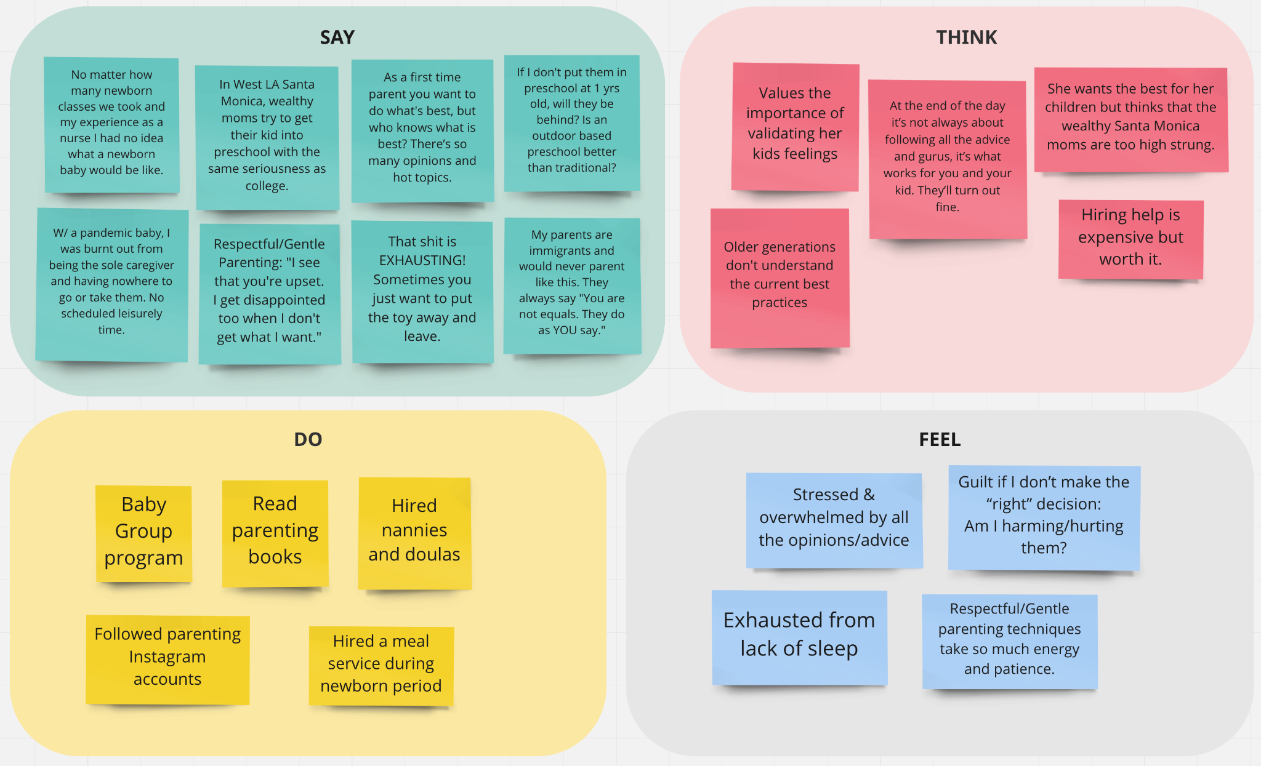

Slide 14

Tensions, Contradictions, Surprises
“I always want to make the best decisions for my children, but it's not always clear.
I'm always second guessing myself.”
While they want the best for their children, they become stressed by the conflicting advice from other parents, baby gurus, social media, books, etc.
“Getting help from my mom and senior family members was hard because of cultural differences. The things they did when I was a baby are outdated now.”
Generational differences in parenting.
Current parents do not want to take their own parents’ advice.
“I operated off so few hours of sleep
I didn't know was possible.”
“I had no scheduled leisure time.”
Lack of sleep and time makes it difficult to balance work, personal life, and childcare.

Slide 15

Initial Insights / Potential Needs
Relationship 👨‍👩‍👧‍👦:
Maintaining the interpersonal relationship between parental figures
Parenting advice 👩‍⚕️:
Finding a “source of truth” for parenting best practices
Time management ⏰:
Tracking baby’s schedule
Allotting time for personal enjoyment as a parent
Social 🗣:
Sharing your struggle (knowing that you are not alone with your parenting challenges)
picture?
Notes:
how do people currently deal with these struggles? how are these needs currently being addressed?

Slide 16



Summary
We talked to parents of young children with different backgrounds.
Parents often struggle with making the “right” parental decisions, managing relationships, managing their time, seeking social support.
For the next steps, we will narrow down the domain focus and prioritize needs.
We also aim to diversify our interviewees.
Notes:
Make sure you say who your participants were, why chosen, how they were recruited/compensated, and where they were interviewed (include images)

Slide 17
Thank you!
Any Questions?

Slide 18
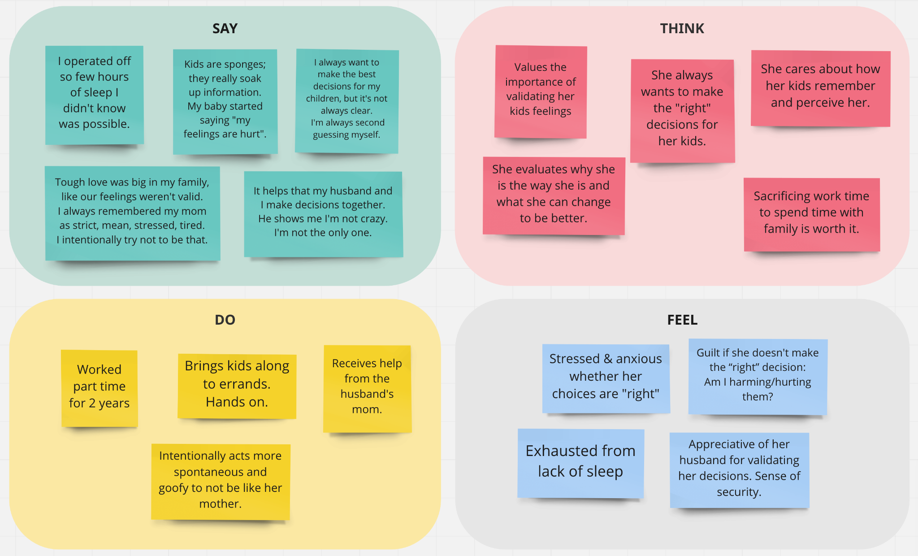

Slide 19
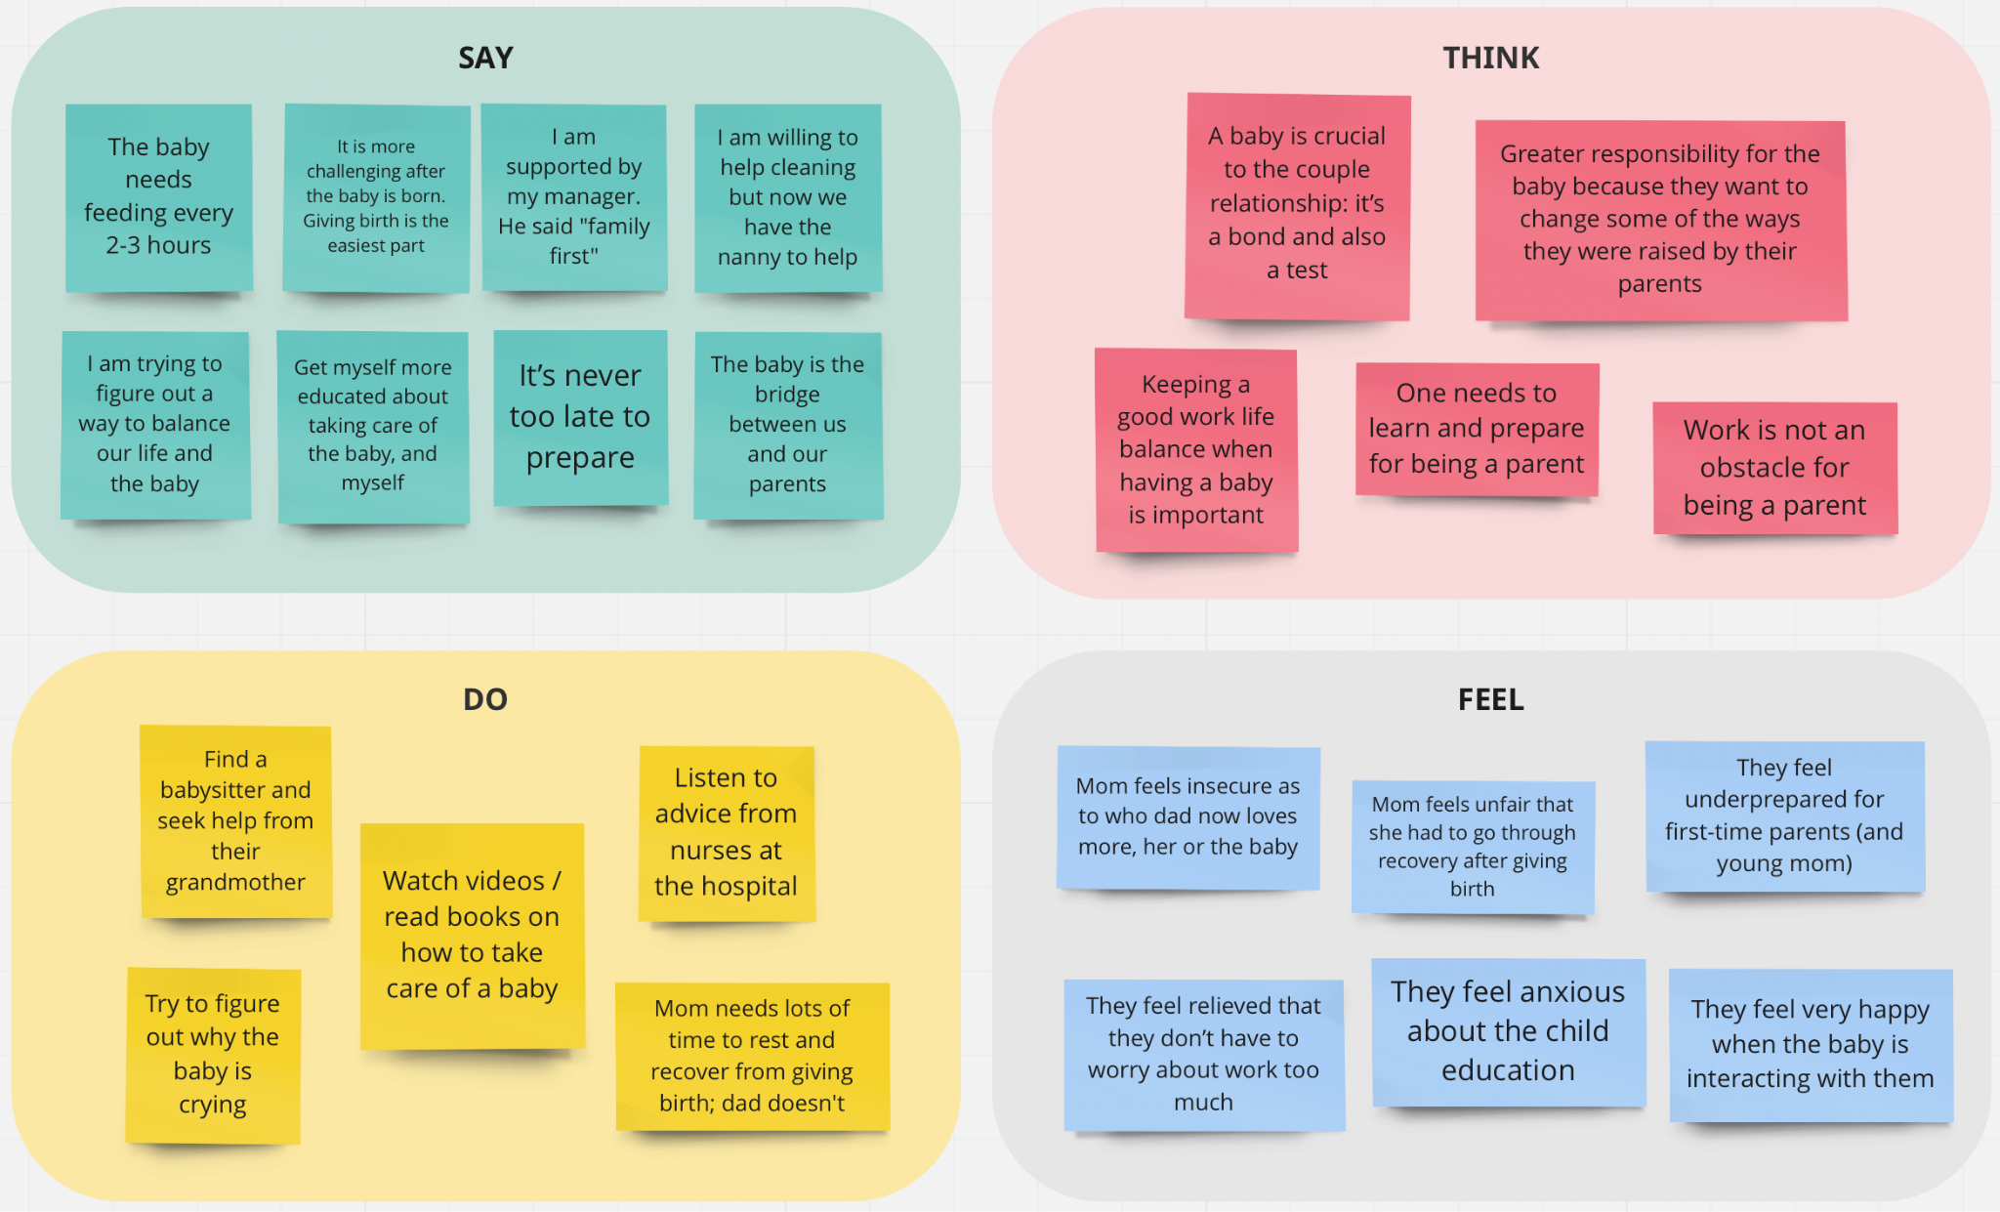

Slide 20
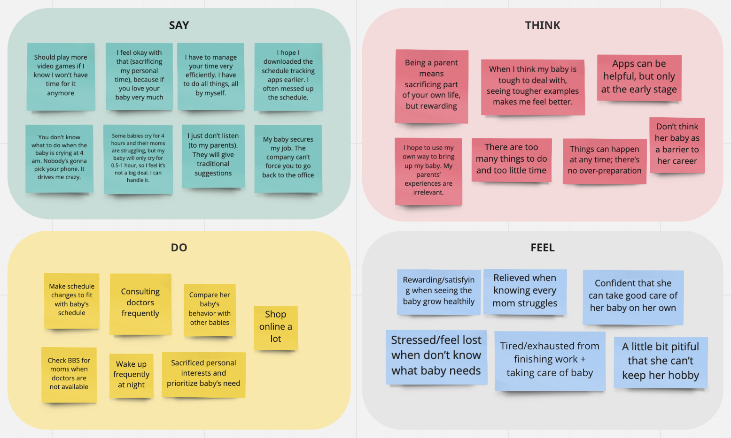

Slide 21
Point of View (POV)
We met…
We were amazed to find…
It would be game-changing to…
Monica, a single mom working as a tech recruiter, with her baby born during COVID-19
How she felt relieved and grateful for her baby after she found out that all moms are struggling on BBS
Encourage moms to share their negative emotions without concern with fellow moms
How much schedule changes she made to adapt to her baby’s schedule
Help moms/parents plan their time efficiently

